Slide 1

Assignment Task for Technical Round
You should be able write an import routine program to import the data (excel file-Bulk Ledger Folder) that has been shared with you, wherein you should be able to meet the following:
You should give an import feature in the system and the data has to be uploaded through UI and it has to get reflected (stored) in the database.
Try to import data to single table and match date wise and head wise transaction of all amounts in commonfee collection,commonfeecollectionheadwise and finacial trans , fianacialtransdetails with that csv file.
The data that has been imported has to be reflected in the front end in the form of report (Head wise Report) where in the total amount for the following parameters has to match in the excel as well as in the frontend or in DB.
- Due Amount
- Paid Amount
- Concession Amount
- Scholarship Amount
- Reverse Concession Amount
- WriteOff Amount
- Adjusted Amount
- Refund Amount
- Fund Transfer Amount
4. Server-side pagination has to be done.
5. Can use core PHP with framework preferably Laravel
Please Note:
Do not use any database triggers
Do not change the DB Structure
Do not split the data, you should be importing the complete data provided in the excel.

Slide 2
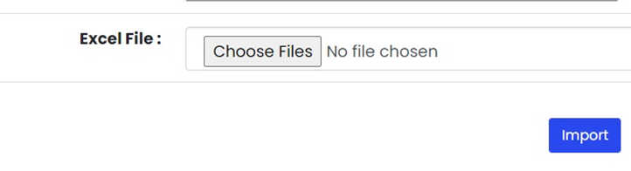
UI Design

Slide 3
Fee collectiontypes come under different modules of:
Academic,
Academic Misc,
Hostel,
Hostel Misc,
Transport,
Transport Misc
Module id can be considered as below:
Academic – 1, Academic Misc – 11
Hostel – 2, Hostel Misc – 22
Transport – 3, Transport Misc – 33
Fee Types(fee head column in excel) are categorized in to:
a) Tuition fee b) Library fee c) Exam fee d) Hostel fee,
e) Transport fee , total(50-54) will come under specific collection
For Example:
-Tuition fee, Exam fee, library are under- Academic .
-fine Fee ,exam paper fine fee –Academic Misc
-Mess fee will be under the collection- Hostel.
Financial Tran types in financial_tran table are as below and each financial trans type can be given an entry mode.
due (debit)D
due reverse (writeoff) (credit) C,
Concession/scholarship (credit)
concession reverse/scholarship reverse (debit)
Opening balance (debit/credit)
Below entry modes can be considered:
due - 0, concession -15,
concession reverse - 16,
opening balance debit/ opening balance credit - D21,
JV Entries - 14,
Misc due - 17,
Misc due reverse - 18
The collection entries will be stored in common_fee_collection table.
Receipt (credit)
Receipt Reverse (debit)
Payment (debit)
Payment Reverse (credit)

Slide 4
Tables to be created
Branches-faculty from csv nearly- 24
Feecategory-feecategory from csv - general ,Saarc NRI,NON saarc NRI need to be mapped to all branches. (3*24)
Feecollectiontypes-academic,academicmisc,hostel,hostelmisc,transport,transportmisc)- need to be mapped to all branches(6*24)
Feetypes-fee heads from csv (50-54)- need to be mapped to all branches-( (50-54)*24)
Entrymode(due,duerev,scholarship,etc..)(12)
Module(academic,academicmisc,hostel,hostelmisc,transport,transportmisc)-6
Financialtran(parent)
Financialtrandetail(child)
Commonfeecollection(parent)
Commonfeecollectionheadwise(child)

Slide 5
id | Branch name
1 | School of Engineering
DB Table: 2 feecategory
DB Table: 3 feecollectiontype
id | fee_category | br_id
1 | general | 30
id | collectionhead | collectiondesc | br_id
79 | Academic | Academic | 30
DB Table: 4 Fee_types
Id | fee_category | f_name | Collection_id | br_id | Seq_id | Fee_type_ledger | Fee_headtype
3024 | 1 | Tuition Fee | 79 | 30 | 1 | Tuition Fee | 1
3025 | 1 | Exam Fee | 79 | 30 | 2 | Exam Fee | 1
fee_category = fee_category id .
f_name = exam fee, tuition fee etc.
Collection_id = collection id of academic, hostel etc.
br_id = if from branches table
Seq_id for fee types (Exam fee, tuition fee etc.)
Fee_type_ledger = = exam fee, tuition fee etc.
Fee_head_type = module id
Create tables for module and entry mode - refer slide 2
Fee type is equal to fee head in Excel

Slide 6
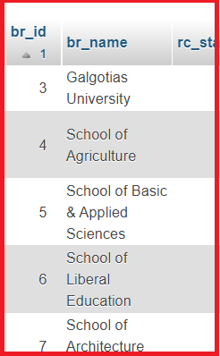
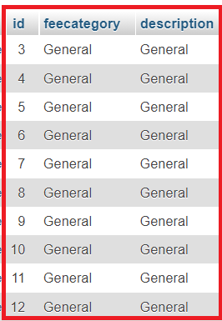

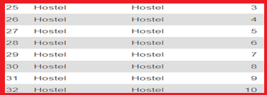
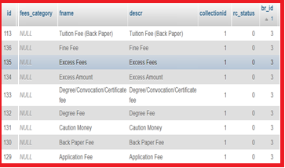
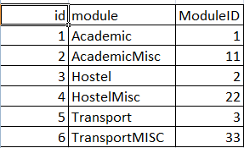
1 Braches(faculty column from excel)
2 feecategory(ppt slide-3)
3.Feecollectiontypes (ppt slide-3)
br_id
id
Collection head
Collection Description
4 .feetypes(feehead column from excel)
5 . Module(ppt slide-3)

Slide 7
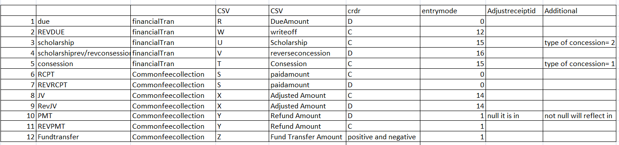
6. entrymode(ppt slide-2)
DB Table: entrymode
id | Entry_modename | crdr | entrymodeno
1 | due | D | 0

Slide 8
DB Table: Financial_trans (Parent Table)
Id | moduleid | tranid | admno | amount | crdr | tranDate | acadYear | Entry mode | voucherno | brid | Type of consession
252026 | 1 | 736331 | 11CETBT101146 | 138000.00 | D | 01-08-2011 | 2011-2012 | 0 | 576499 | 1 | Either 1 or 2 based on entry
id | financialTranId | moduleId | amount | headId | crdr | brid | head_name
656280 | 252026 | 1 | 128000.00 | 3024 | D | 30 | Tution Fee
656281 | 252026 | 1 | 10000.00 | 3025 | D | 30 | Security Fee
DB Table: Financial_tran_details (Child Table)
DB Table: Financial_transdetail (Child Table)

Slide 9
DB Table: Common_fee_collection (Parent Table)
id | moduleId | transId | admno | rollno | amount | brId | acadamicYear | financialYear
534873 | 1 | 668214 | 20GCFC1030009 | 3171T020CUGCFC101N003 | 97000.00 | 1 | 2016-2017 | 2016-2017
displayReceiptNo | Entrymode | Paid Date | inactive
2020-2021/AIE/C13/2169 | 0 | 28-08-2020 | Either 0/1 based on entry and rev entry respectively
DB Table: Common_fee_collection_headwise (Child Table)
id | moduleId | receiptId | headId | headName | brid | amount
1086394 | 1 | 534873 | 3026 | Tution Fee | 1 | 87000.00
1086394 | 1 | 534873 | 3027 | Exam Fee | 1 | 10000.00

Slide 10
Output in UI should be in the form of reports as shown below:
The amounts should reflect head wise
Report 1
Admno | Roll no | Receipt no | Receipt Date | Academic Year | Due Amount | Paid Amount | Concession Amount | Scholarship Amount | Reverse Concession Amount | WriteOff Amount | Adjusted Amount | Refund Amount | Fund Transfer Amount
001 | RS01 | 161656 | 12.02.2021 | 2016-2017 |  | 2000.00
002 | RS02 | 142563 | 14.02.2021 | 2016-2017 |  |  |  |  | 100.00
Report 2
Admno | Roll no | Amount | Receipt no | Receipt Date | Academic Year | Tuition Fee | Exam Fee | Library Fee | Sports Fee | Degree fee | Other fee | Misc Fee | Convocation Fee | Fine fee | Vochure Type
001 | RS01 | 2000.00 | 161656 | 12.02.2021 | 2016-2017 | 1000.00 |  |  |  | 1000.00
002 | RS02 | 1400.00 | 142563 | 14.02.2021 | 2016-2017 |  |  | 1200.00 |  |  | 200.00

Slide 11
Thankyou !!!
Wish you all the best !!!

